Slide 1
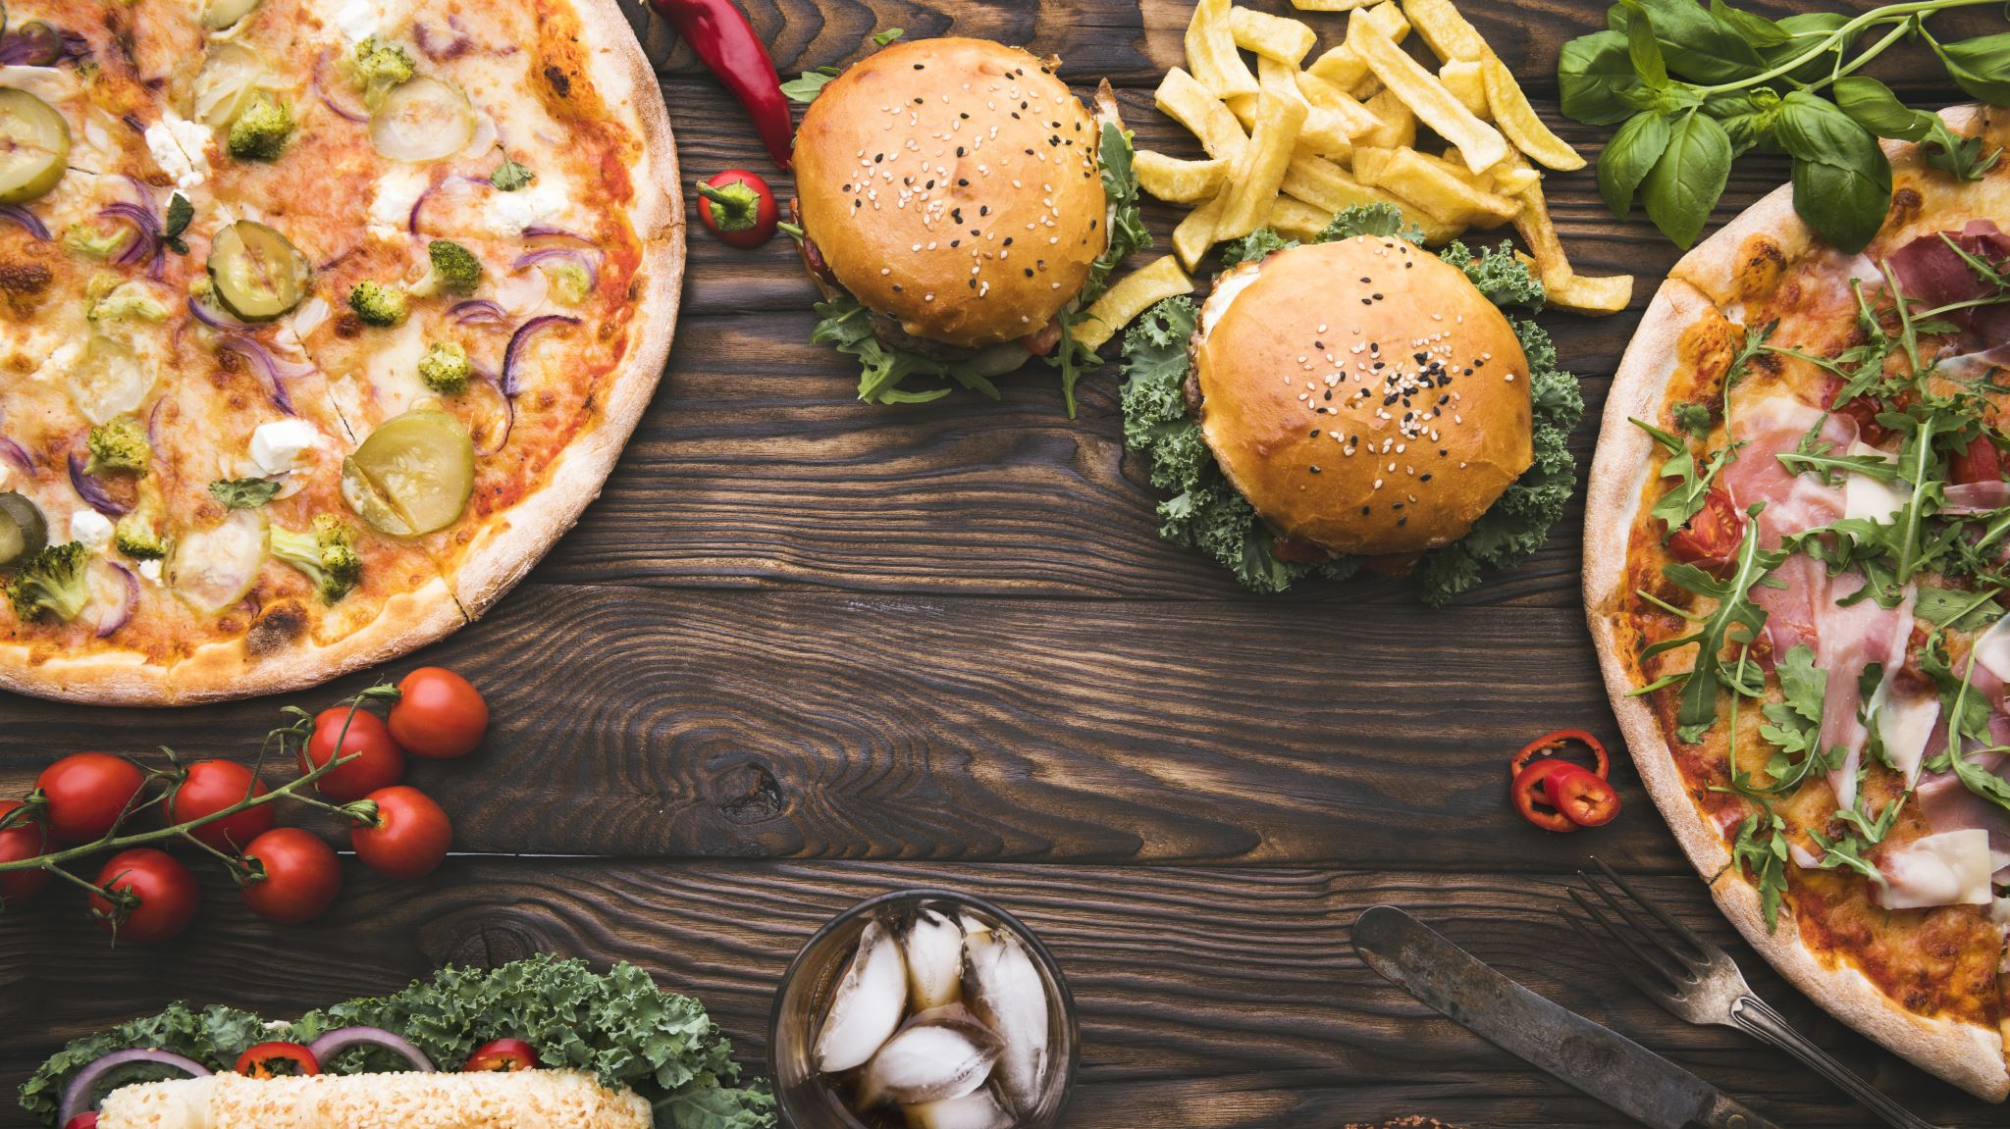
Pizza Store Location Opportunity
July 5, 2020

Slide 2
Determining Location by Postal Code
The success of a pizza store requires customers that are willing and able to pay the price of the product.
Pizza sales are repeat sales. Stores increase market share by attracting customers from other pizza shops once the market has been completely penetrated.
Low income areas have low or no disposable income to purchase things other than necessities.

Slide 3
Data acquisition and cleaning
Searched for Pizza stores using Foursquare. Obtained 29 locations in the Kansas City area.
Postal Code and the number times that it appeared was the most important data extracted. The number of times that a Postal Code appeared was equal to a pizza store location.
Obtained population by Postal Codes from Zip.org. Cleansed Postal Codes to 9 Postal Codes from 50 Postal Codes.
Obtained median income by Postal Code from incomebyzipcode.com/Missouri.

Slide 4
K-Means
Clustering
Four clusters by Postal Code were processed. The clusters were used to identify how Postal Codes were grouped.
Clusters were used to assist with analyzing the relationship between median income, population, and pizza store count by Postal Code.

Slide 5
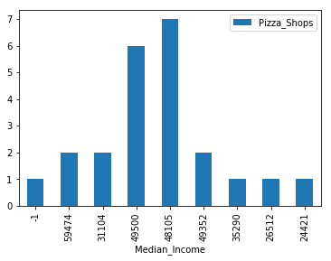
Relationship of Median Income to Store Count

Slide 6
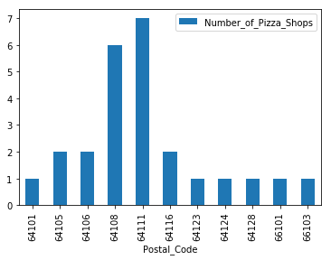
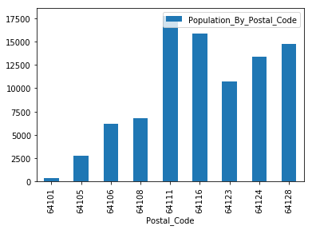
Pizza Shops to Population
Pizza Shops
Population

Slide 7
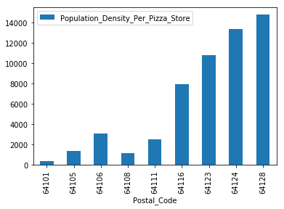
Population Count Per Store
Population
Population per Store

Slide 8
Conclusion and future directions
Conclusion
High median income and high population density is required to support multiple pizza stores and have more pizza stores.
Postal Codes with low median income and low population density have one pizza store.
Future
A more thorough analysis is required to better understand the relationship between family structure, age, and convenience.
A better understanding of demand drivers is required. The lack of time could also be a factor along with population and median income in determining pizza demand.
Investigate why certain markets are underserved.

